Slide 1
Cooking Merit Badge
Based on BSA 2016 Requirements
Troop 88 - Gilbert, AZ
Notes:
Cooking merit badge requirements
Note: The meals prepared for Cooking merit badge requirements 4, 5, and 6 will count only toward fulfilling those requirements and will not count toward rank advancement or other merit badges. Meals prepared for rank advance¬ment or other merit badges may not count toward the Cooking merit badge. You must not repeat any menus for meals actually prepared or cooked in requirements 4, 5, and 6.Health and safety. Do the following:a. Explain to your counselor the most likely hazards you may encounter while participating in cooking activities and what you should do to anticipate, help prevent, mitigate, and respond to these hazards.b. Show that you know first aid for and how to prevent injuries or illnesses that could occur while preparing meals and eating, including burns and scalds, cuts, choking, and allergic reactions.c. Describe how meat, fish, chicken, eggs, dairy products, and fresh vegetables should be stored, transported, and properly prepared for cooking. Explain how to prevent cross-contamination.d. Discuss with your counselor food allergies, food intolerance, and food-related illnesses and diseases. Explain why someone who handles or prepares food needs to be aware of these concerns.e. Discuss with your counselor why reading food labels is important. Explain how to identify common allergens such as peanuts, tree nuts, milk, eggs, wheat, soy, and shellfish.
Nutrition. Do the following:a. Using the MyPlate food guide or the current USDA nutrition model, give five examples for EACH of the following food groups, the recommended number of daily servings, and the recommended serving size:1. Fruits2. Vegetables3. Grains4. Proteins5. Dairyb. Explain why you should limit your intake of oils and sugars.c. Determine your daily level of activity and your caloric need based on your activity level. Then, based on the MyPlate food guide, discuss with your counselor an appropriate meal plan for yourself for one day.d. Discuss your current eating habits with your counselor and what you can do to eat healthier, based on the MyPlate food guide.e. Discuss the following food label terms: calorie, fat, saturated fat, trans fat, cholesterol, sodium, carbohydrate, dietary fiber, sugar, protein. Explain how to calculate total carbohydrates and nutritional values for two servings, based on the serving size specified on the label.
Cooking basics. Do the following:a. Discuss EACH of the following cooking methods. For each one, describe the equipment needed, how temperature control is maintained, and name at least one food that can be cooked using that method: baking, boiling, broiling, pan frying, simmering, steaming, microwaving, grilling, foil cooking, and use of a Dutch oven.b. Discuss the benefits of using a camp stove on an outing vs. a charcoal or wood fire.c. Describe with your counselor how to manage your time when preparing a meal so components for each course are ready to serve at the same time.
Cooking at home. Using the MyPlate food guide or the current USDA nutrition model, plan a menu for three full days of meals (three breakfasts, three lunches, and three dinners) plus one dessert. Your menu should include enough to feed yourself and at least one adult, keeping in mind any special needs (such as food allergies) and how you kept your foods safe and free from cross-contamination. List the equipment and utensils needed to prepare and serve these meals.Then do the following:a. Create a shopping list for your meals showing the amount of food needed to prepare and serve each meal, and the cost for each meal.b. Share and discuss your meal plan and shopping list with your counselor.c. Using at least five of the 10 cooking methods from requirement 3, prepare and serve yourself and at least one adult (parent, family member, guardian, or other responsible adult) one breakfast, one lunch, one dinner, and one dessert from the meals you planned. *d. Time your cooking to have each meal ready to serve at the proper time. Have an adult verify the preparation of the meal to your counselor.e. After each meal, ask a person you served to evaluate the meal on presentation and taste, then evaluate your own meal. Discuss what you learned with your counselor, including any adjustments that could have improved or enhanced your meals. Tell how better planning and preparation help ensure a successful meal.
Camp cooking. Do the following:a. Using the MyPlate food guide or the current USDA nutrition model, plan a menu for your patrol (or a similar size group of up to eight youth, including you) for a camping trip. Your menu should include enough food for each person, keeping in mind any special needs (such as food allergies) and how you keep your foods safe and free from cross-contamination. These five meals must include at least one breakfast, one lunch, one dinner, AND at least one snack OR one dessert. List the equipment and utensils needed to prepare and serve these meals.b. Create a shopping list for your meals showing the amount of food needed to prepare and serve each meal, and the cost for each meal.c. Share and discuss your meal plan and shopping list with your counselor.d. In the outdoors, using your menu plan for this requirement, cook two of the five meals you planned using either a lightweight stove or a low-impact fire. Use a different cooking method from requirement 3 for each meal. You must also cook a third meal using either a Dutch oven OR a foil pack OR kabobs. Serve all of these meals to your patrol or a group of youth. **e. In the outdoors, prepare a dessert OR a snack and serve it to your patrol or a group of youth.**f. After each meal, have those you served evaluate the meal on presentation and taste, and then evaluate your own meal. Discuss what you learned with your counselor, including any adjustments that could have improved or enhanced your meals. Tell how planning and preparation help ensure successful outdoor cooking.g. Explain to your counselor how you cleaned the equipment, utensils, and the cooking site thoroughly after each meal. Explain how you properly disposed of dishwater and of all garbage.h. Discuss how you followed the Outdoor Code and no-trace principles when preparing your meals.
Trail and backpacking meals. Do the following:a. Using the MyPlate food guide or the current USDA nutrition model, plan a menu for trail hiking or backpacking that includes one breakfast, one lunch, one dinner, and one snack. These meals must not require refrigeration and are to be consumed by three to five people (including you). Be sure to keep in mind any special needs (such as food allergies) and how you will keep your foods safe and free from cross-contamination. List the equipment and utensils needed to prepare and serve these meals.b. Create a shopping list for your meals, showing the amount of food needed to prepare and serve each meal, and the cost for each meal.c. Share and discuss your meal plan and shopping list with your counselor. Your plan must include how to repackage foods for your hike or backpacking trip to eliminate as much bulk, weight, and garbage as possible.d. While on a trail hike or backpacking trip, prepare and serve two meals and a snack from the menu planned for this requirement. At least one of those meals must be cooked over a fire, or an approved trail stove (with proper supervision).**e. After each meal, have those you served evaluate the meal on presentation and taste, then evaluate your own meal. Discuss what you learned with your counselor, including any adjustments that could have improved or enhanced your meals. Tell how planning and preparation help ensure successful trail hiking or backpacking meals.f. Discuss how you followed the Outdoor Code and no-trace principles during your outing. Explain to your counselor how you cleaned any equipment, utensils, and the cooking site after each meal. Explain how you properly disposed of any dishwater and packed out all garbage.
Food-related careers. Find out about three career opportunities in cooking. Select one and find out the education, training, and experience required for this profession. Discuss this with your counselor, and explain why this profession might interest you.

Slide 2
Week 1 & 2
Nutrition

Slide 3
Nutrition
Do the following: Using the MyPlate food guide or the current USDA nutrition model, give five examples for EACH of the following food groups, the recommended number of daily servings, and the recommended serving size:1. Fruits2. Vegetables3. Grains4. Proteins5. Dairy Explain why you should limit your intake of oils and sugars. Determine your daily level of activity and your caloric need based on your activity level. Then, based on the MyPlate food guide, discuss with your counselor an appropriate meal plan for yourself for one day. Discuss your current eating habits with your counselor and what you can do to eat healthier, based on the MyPlate food guide. Discuss the following food label terms: calorie, fat, saturated fat, trans fat, cholesterol, sodium, carbohydrate, dietary fiber, sugar, protein. Explain how to calculate total carbohydrates and nutritional values for two servings, based on the serving size specified on the label.

Slide 4
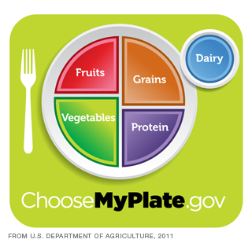
NUTRITION
Notes:
Plate method handouts – demonstrate planning a meal with the myplate worksheet

Slide 5
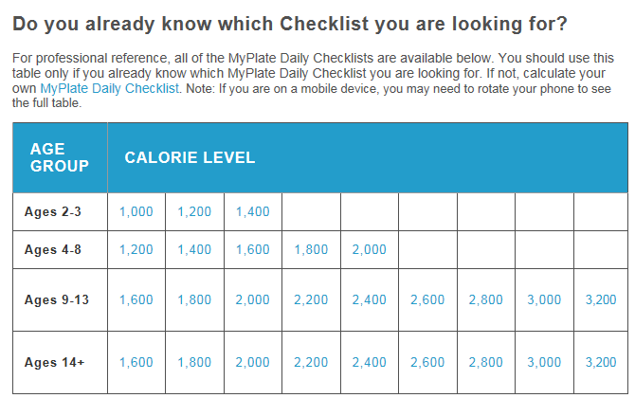
MyPlate Checklist

Slide 6
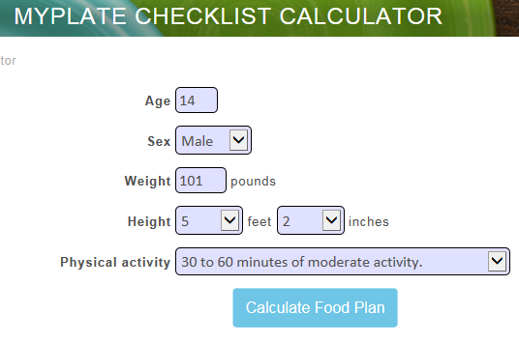
Calculator

Slide 7
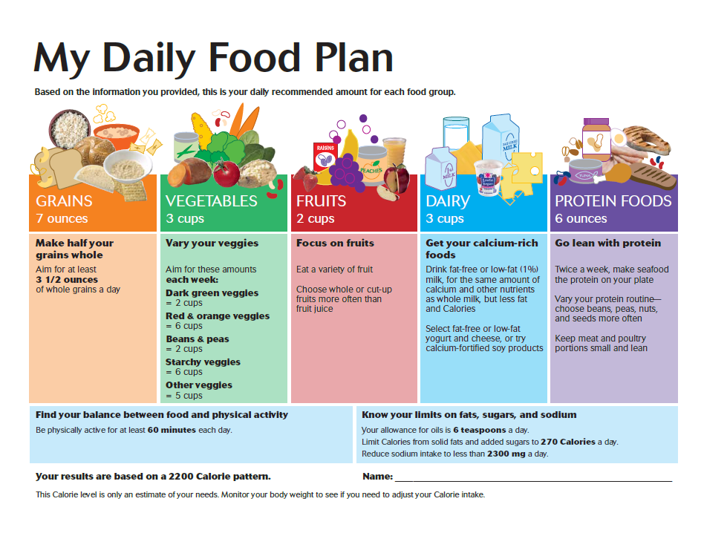

Slide 8
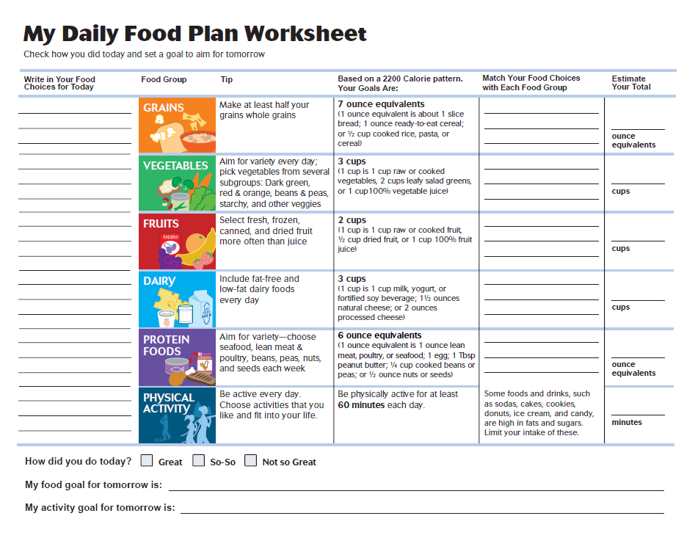

Slide 9
NUTRITION
MyPlate Meal Planning
  Fruits
  Vegetables
  Grains
  Proteins
  Dairy
Lets see how we did on our sack lunches today
  Discussion – does your sack lunch meet the myplate guidelines?

Slide 10
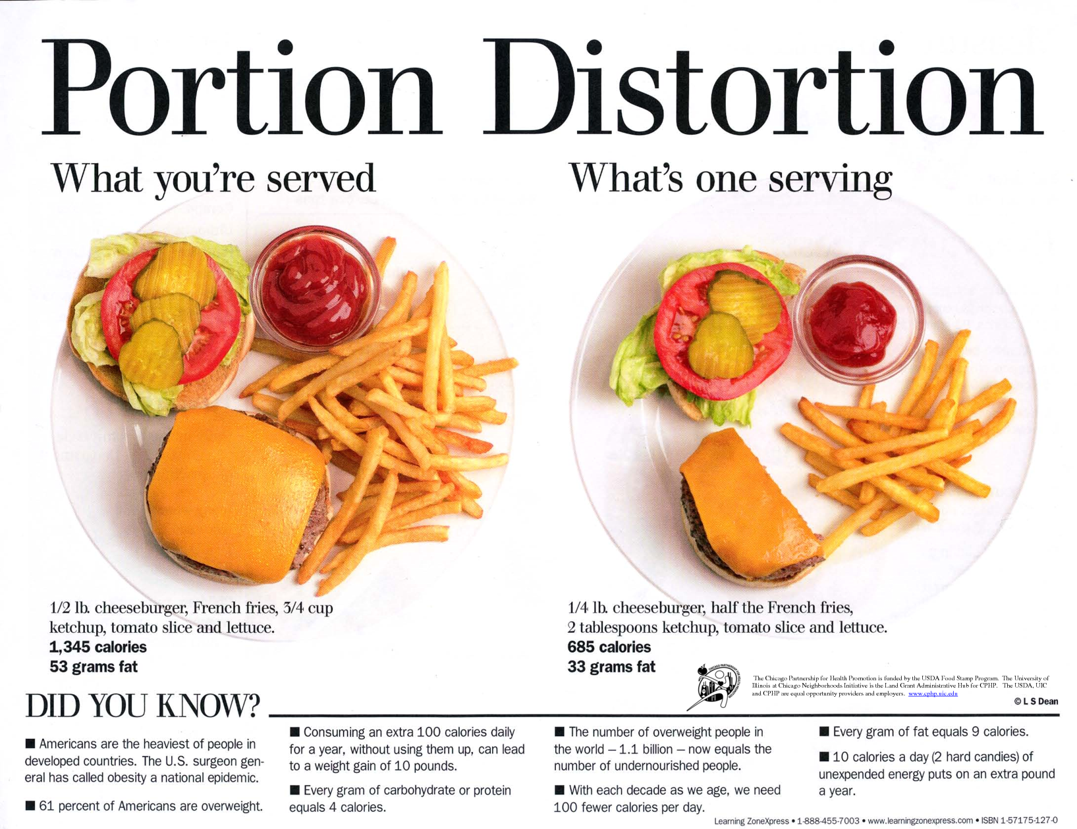
NUTRITION
Notes:
4myheart portion size handouts
Examples of too big vs appropriate portions
Does anyone know how many calories are in 1lb of fat? A. 3,500
So to burn 1lb of fat, you need to cut calories 500 per day for a week.

Slide 11
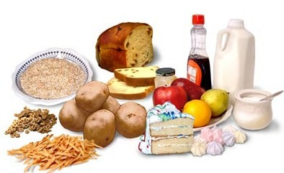
NUTRITION
Carbohydrates – Good vs. Bad

Slide 12
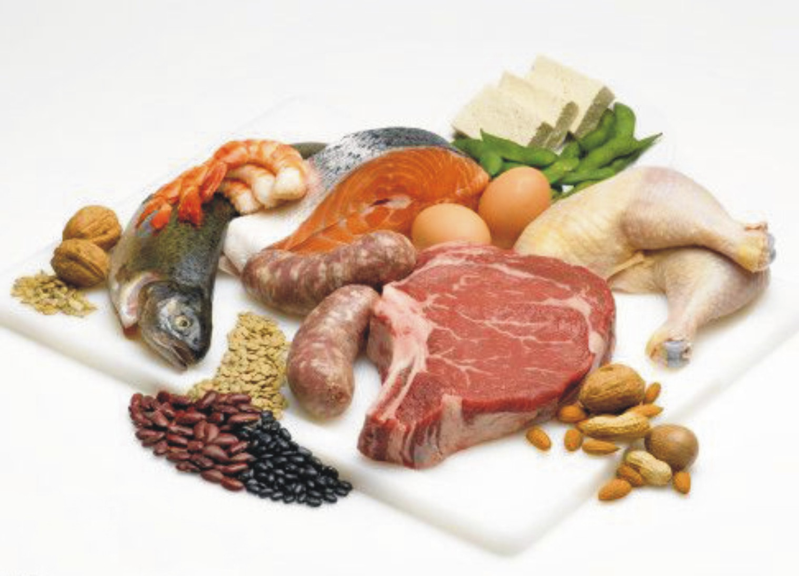
NUTRITION
Protein – Good vs. Bad
Notes:
Good
Seafood
White- Meat Poultry
Milk, Cheese, and Yogurt
Eggs
Beans
Pork Tenderloin
Soy
Lean Beef
Bad
Bratwurst
Sausage
Burgers
Hot Dogs
Bacon

Slide 13

NUTRITION
Saturated fats occur naturally in many foods. The majority come mainly from animal sources, including meat and dairy products. Examples are fatty beef, lamb, pork, poultry with skin, beef fat (tallow), lard and cream, butter, cheese and other dairy products made from whole or reduced-fat (2 percent) milk. These foods also contain dietary cholesterol.
In addition, many baked goods and fried foods can contain high levels of saturated fats. Some plant foods, such as palm oil, palm kernel oil and coconut oil, also contain primarily saturated fats, but do not contain cholesterol.

Slide 14

NUTRITION
Trans fats (or trans fatty acids) are created in an industrial process that adds hydrogen to liquid vegetable oils to make them more solid. Another name for trans fats is “partially hydrogenated oils." Look for them on the ingredient list on food packages.
Trans fats can be found in many foods – but especially in fried foods like French fries and doughnuts, and baked goods including pastries, pie crusts, biscuits, pizza dough, cookies, crackers, and stick margarines and shortenings. You can also spot trans fats by reading ingredient lists and looking for the ingredients referred to as “partially hydrogenated oils.”

Slide 15
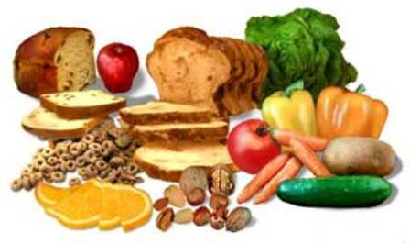
NUTRITION
Dietary Fiber
Sodium
Naturally occurring sodium is in foods such as celery, beets and milk. Packaged and prepared foods, like canned soups, lunch meats and frozen dinners, often have sodium added during manufacturing. This sodium might be in the form of salt or other forms of sodium (like baking soda) that show up in our food.

Slide 16
NUTRITION
Fruit and Vegetables
  5 servings per day of fruit and veggies
  5 different colors should be the goal
  At least one serving should be green
Fruit contains sugar although it is natural sugar. 2 servings per day is usually enough.
Vegetables should be half of the content of your plate

Slide 17
NUTRITION
Sugar
  4 grams of sugar = 1 teaspoon of sugar
  Human body is only designed to handle 16 to 20 grams per day
  Average child or teen in U.S. consumes 40 to 80 teaspoons of sugar per day
  1 official serving size of Cheerios has 10 grams of sugar

Slide 18
NUTRITION
Why sugar is a problem
  Body cannot process more than 16-20 grams per day
  Too much overloads the pancreas, and burns up the ability to produce insulin
  Sugar and processed carbs show up as triglycerides when cholesterol is checked
  Diabetes then develops – 40% of diabetics have significantly shortened lifespan due to stroke, kidney failure and heart attack
  4 grams = 1 teaspoon
Notes:
Lets talk about your favorite foods and foods we see advertised!
What kinds of foods have added, artificial or processed sugars?
How much sugar do they have?
How much sugar do you eat in a day?
How can we avoid sugar?
How is labeling and marketing designed to deceive you about the nutritional value of the foods you eat? Why?

Slide 19
NUTRITION
Sugar Facts
  8 ounces (1 cup) of sweetened drink per day will result in 15 lbs of excess weight gain per year (Soda, tea, vitamin water, gatorade, etc)
  The average school lunch contains 20 teaspoons (80 grams) of sugar. Breakfast is even worse
  There is no such thing as store bought healthy yogurt. Today’s mass produced yogurt is simply ice cream
  Artificial sweeteners have even more side effects and cause as many or more problems than sugar.

Slide 20
NUTRITION
Calories
  Calories are used to measure the amount of energy potential in foods
  Humans need calories to produce energy in the same way that a fire needs wood to produce heat
  Calories are burned by all activities – even sleeping and breathing
  Heavy or strenuous activity burns more calories than sedentary activity

Slide 21
NUTRITION
  In general calorie requirements are around 2200 calories per day for most older teens and adults (males). Females require a little less, young and growing kids need more.
  In any given day, calories should be…
    40% from protein
    30% from carbohydrate
    30% from fat
  Not enough calories = excess weight loss
  Too many calories = excess weight gain
  Rate of burn for different calories – slow burning is usually preferred over fast burning, except during heavy bursts of activity. Sometimes you need both!

Slide 22
NUTRITION
Activities which increase calorie needs:
  Cold weather
    More fat calories
    Hot food and drinks so the body doesn’t have to burn so many calories to maintain warmth
  Endurance activities
    Protein, slow and fast burning carbohydrates
  Short high intensity activities
    Protein, fast burning carbohydrates
Notes:
Slow Burning Carbs: cherries, plums, grapefruit, apples, pears, grapes, oranges, prunes, dried apricots, kiwi and peaches.
Peas, carrots, eggplant, cauliflower, broccoli, onions, lettuce, tomatoes, green beans and red peppers
oat bran, rolled oats, whole-grain pumpernickel bread, whole-wheat bread, spaghetti, brown rice, pearled barley and wheat tortillas
Kidney beans, butter beans, chickpeas, black-eyed peas, navy beans, lentils and yellow split peas
Fast Burning Carbs: milk, sugar, white bread, white pasta, refined flour

Slide 23
NUTRITION
Calculating Calorie Needs
There are a number of complex formulas for determining caloric needs
Several things play a role
  Age
  Weight & Height
  Level of activity
Multiple calculators available on internet
Average teen male needs 2000 to 2400 calories a day for low to moderate activity

Slide 24
NUTRITION
Electrolytes
  When sweating people need more of the following:
    Sodium
    Magnesium
    Potassium
  Without electrolytes your heart and muscles will not work properly
  Replacing water alone is not enough – too little electrolytes and too much with water is a dangerous combination
  If it is windy or very dry, you may even not know that you are sweating
  In hot or arid weather, alternate every other bottle of water with a bottle of electrolyte solution

Slide 25
NUTRITION
How to read food labels
See Handout
Notes:
Food labels handout

Slide 26
NUTRITION
Putting it all together
Individually
  Plan 1 meal on the myplate worksheets
In small groups…
  Plan 2 meals on the myplate worksheet
  Discuss the meals you have planned with your group
  Give and receive feedback to other group members about the meal plans

Slide 27
NEXT
Need a couple of volunteers to do the following for the next meeting:
  With your parents permission, visit www.calorieking.com
  Have them sign you up for a free 7 day trial
  Using calorie king, keep a diary of the foods you eat and the exercise you do for the next 7 days
  Be sure and log the “little extras” like butter, dressing etc.
  Bring a print out of the diary with you to the next classroom session
(The diary itself is not a requirement for the merit badge, but we will use it to take a look at our usual eating habits and compare it to healthy eating)
Notes:
www.calorieking.com

Slide 28
Week 3
Health & Safety

Slide 29
Health & Safety
Do the following: Explain to your counselor the most likely hazards you may encounter while participating in cooking activities and what you should do to anticipate, help prevent, mitigate, and respond to these hazards. Show that you know first aid for and how to prevent injuries or illnesses that could occur while preparing meals and eating, including burns and scalds, cuts, choking, and allergic reactions. Describe how meat, fish, chicken, eggs, dairy products, and fresh vegetables should be stored, transported, and properly prepared for cooking. Explain how to prevent cross-contamination. Discuss with your counselor food allergies, food intolerance, and food-related illnesses and diseases. Explain why someone who handles or prepares food needs to be aware of these concerns. Discuss with your counselor why reading food labels is important. Explain how to identify common allergens such as peanuts, tree nuts, milk, eggs, wheat, soy, and shellfish.

Slide 30
SAFETY
Likely Hazards
  Cuts
  Burns & Scalds
  Choking
  Allergic Reactions
  Food Borne Illness
Know first aid for all of them but…

Slide 31
SAFETY
The first step in first aid is prevention
If you are the grub master how might you prevent the following?
  Choking
  Burns & Scalds
  Cuts
  Allergic Reactions
  Food borne illness

Slide 32
SAFETY
Stove Safety
  Never use or light near, or in, a tent or enclosed area
  Maintain stoves to mfg specifications.
  Store fuel only in approved containers
  Allow hot stoves to cool before storing, etc.
  Never leave a lighted stove unattended
  Do not overload with large or overly full pot
  Use pot grabbers to pick up hot items
Notes:
Why are these points important?

Slide 33
SAFETY
Common food allergens:
  Peanuts – often life threatening
  Tree Nuts
  Eggs
  Shellfish
  Milk
  Wheat
  Soy
Notes:
Epi Pen demo

Slide 34
SAFETY
Food Borne Illness
  Almost always preventable
  Most often caused by improper storage, handling or cooking of food products, Inadequate HAND WASHING, or cleaning of utensils or surfaces
  Most commonly associated with meat, seafood, eggs, dairy products, and produce

Slide 35
SAFETY
Raw Meat & Dairy must be kept cold
  Less than 40 degrees Fahrenheit
Meat should be cooked soon after removing from refrigeration
Cooked food should be kept hot
  above 140 degrees Fahrenheit
Keep COLD foods COLD, and HOT foods HOT
USE A FOOD THERMOMETER IF IN DOUBT
Notes:
Ice chests with various contents – thermometers in each for checking temperature
Couple of types of food and meat thermometers
Laminated food/meat temp cooking chart cards

Slide 36
SAFETY
Check seals on food in jars, containers or bags
Freeze raw meat if it will not be used within 2 days.
Discard leftovers if not eaten within three days
Keep raw meat separate from other foods
WASH HANDS frequently while cooking

Slide 37
SAFETY
Parasitic diseases
  Worms and little critters
  http://www.cdc.gov/parasites/az/index.html
Bacterial diseases
  Microscopic single celled organisms
Viral diseases
  Subcellular, or prion particle
  Uses host organism’s cells to live

Slide 38
SAFETY
Campylobacter jejuni (C. jejuni)
  Contaminated water, raw or unpasteurized milk and raw or undercooked meats, poultry, or seafood.
  Symptoms
    Diarrhea, abdominal pain, nausea, headache and fever. Symptoms may appear 2-5 days after exposure and last 5-7 days.
  Prevention
    Properly cook chicken, meat and seafood to a safe internal temperature.
    Consume only pasteurized milk and juice and water that comes from trusted sources.
    WASH HANDS with soap and warm water, and scrub under fingernails after using the bathroom
Notes:
Symptoms include diarrhea, abdominal pain, nausea, headache and fever. Caused by contaminated water, raw or unpasteurized milk and raw or undercooked meats, poultry, or seafood
Properly cook chicken, meat and seafood to a safe internal temperature; consume only pasteurized milk and juice and water that comes from trusted sources; WASH HANDS with soap and warm water, and scrub under fingernails after using the bathroom

Slide 39
SAFETY
Botulism
  A deadly disease caused by failure to maintain food at proper temperatures, in properly sealed containers
  Symptoms
    dry mouth, double vision, nausea, vomiting, diarrhea, abdominal cramps, sore throat, dizziness, constipation, muscle weakness, muscle paralysis, difficulty swallowing and breathing
  Prevention
    never use food from bulging containers/cans, strange odor or appearance, refrigerate leftovers quickly, and reheat all refrigerated leftover foods to proper temperature
Notes:
Symptoms include dry mouth, double vision, nausea, vomiting, diarrhea, abdominal cramps, sore throat, dizziness, constipation, muscle weakness, muscle paralysis, difficulty swallowing and breathing. Caused by failure to maintain food at proper temperatures, in properly sealed containers
Never use food from bulging containers/cans, strange odor or appearance, refrigerate leftovers quickly, and reheat all refrigerated leftover foods to proper temperature

Slide 40
SAFETY
Cryptosporidium
  Drinking water, recreational water (lakes, public pools and hot tubs) and contaminated foods.
  Symptoms
    Dehydration, diarrhea, abdominal pain, nausea, vomiting, fever and weight loss. Symptoms may appear 2-10 days after exposure and last 7-14 days.
  Prevention
    WASH HANDS with soap and warm water, and scrub under fingernails before and after handling raw food.
    Wash all fruits and vegetables.
    Avoid water that may be contaminated and do not drink from swimming pools or untreated water from shallow wells, rivers, lakes, etc.
Notes:
Comes from contact with contaminated drinking water, recreational water (lakes, public pools and hot tubs) and contaminated foods; Dehydration, diarrhea, abdominal pain, nausea, vomiting, fever and weight loss. Symptoms may appear 2-10 days after exposure and last 7-14 days.
WASH HANDS with soap and warm water, and scrub under fingernails before and after handling raw food; Wash all fruits and vegetables; Avoid water that may be contaminated and do not drink from swimming pools or untreated water from shallow wells, rivers, lakes, etc.

Slide 41
SAFETY
Escherichia Coli Enteritis (E. Coli)
  Bacteria present in human poop, can be transmitted from one person to another, can be a deadly illness for elderly adults and young children.
  Symptoms
    nausea, vomiting, diarrhea, fever, and abdominal cramps.
  Prevention
    WASH HANDS after using restroom or after handling raw produce
    Refrigerate foods below 44 degrees
    Wash all fresh produce

Slide 42
SAFETY
Hepatitis
  Hepatitis A virus can be present in human poop
  Symptoms
    Fever, Fatigue, Loss of appetite, Nausea, Vomiting, Abdominal pain, Grey-colored stools, Dark urine, Joint pain, Jaundice
  Prevention
    A vaccine can prevent this disease
    WASH HANDS with soap and warm water, and scrub under fingernails prior to handling food
    Cook shellfish thoroughly
    Drink water from approved sources only
    Keep bathrooms clean and disinfected
Notes:
What is hepatitis?
“Hepatitis” means inflammation of the liver. The liver is a vital organ that processes nutrients, filters the blood, and fights infections. When the liver is inflamed or damaged, its function can be affected.
Hepatitis is most often caused by a virus. In the United States, the most common types of viral hepatitis are Hepatitis A, Hepatitis B, and Hepatitis C. Heavy alcohol use, toxins, some medications, and certain medical conditions can also cause hepatitis.
What is Hepatitis A?
Hepatitis A is a contagious liver disease that results from infection with the Hepatitis A virus. It can range in severity from a mild illness lasting a few weeks to a severe illness lasting several months.
Who is at risk?
Although anyone can get Hepatitis A, some people are at greater risk, such as those who:
• Travel to or live in countries where Hepatitis A is common• Ha ve sexual contact with someone who has Hepatitis A • A re men who have sexual encounters with other men
• Use recreational drugs, whether injected or not • Have clotting-factor disorders, such as hemophilia• Are household members or caregivers of a person infected with Hepatitis A
How common is Hepatitis A?
Hepatitis A still occurs in the United States, although not as frequently as it once did. Over the last 20 years, there has been more than a 90% decrease in Hepatitis A cases. New cases are now estimated to be around 20,000 each year. Many experts believe this decline is a result of the vaccination of children and people at risk for Hepatitis A.
How is Hepatitis A spread?
Hepatitis A is usually spread when a person ingests fecal matter—even in microscopic amounts—from contact with objects, food, or drinks contaminated by feces or stool from an infected person.
Hepatitis A can be spread when:
• An infected person does not wash his or her hands properly after going to the bathroom and then touches objects or food
• A caregiver does not properly wash his or her hands after changing diapers or cleaning up the stool of an infected person
• Someone engages in certain sexual activities, such as oral-anal contact with an infected person
Hepatitis A also can be spread through contaminated food or water. This most often occurs in countries where Hepatitis A is common, especially if personal hygiene or sanitary conditions are poor. Contamination of food can happen at any point: growing, harvesting, processing, handling, and even after cooking.
What are the symptoms of Hepatitis A?
Not everyone has symptoms. If symptoms develop, they usually appear 2 to 6 weeks after becoming infected and can include:
• Fever
• Fatigue
• Loss of appetite
• Nausea
• Vomiting
• Abdominal pain
• Grey-colored stools
• Dark urine
• Joint pain
• Jaundice
Symptoms are more likely to occur in adults than in children. They usually last less than 2 months, although some people can be ill for as long as 6 months.
People can spread Hepatitis A even if they don’t look or feel sick. Many children and some adults have no symptoms.
How is Hepatitis A diagnosed and treated?
A doctor can determine if a person has Hepatitis A by discussing his or her symptoms and taking a blood sample. To treat Hepatitis A, doctors usually recommend rest, adequate nutrition, fluids, and medical monitoring. Some people will need to be hospitalized. It can take a few months before people begin to feel better.
How serious is Hepatitis A?
Most people who get Hepatitis A feel sick for several months, but they usually recover completely and do not have lasting liver damage. Sometimes Hepatitis A can cause liver failure and death, although this is rare and occurs more commonly in people older than 50 and people with other liver diseases.
Can Hepatitis A be prevented?
Yes. The best way to prevent Hepatitis A is by getting vaccinated. Experts recommend the vaccine for all children, some international travelers, and people with certain risk factors and medical conditions. The Hepatitis A vaccine is safe and effective and given as 2 shots, 6 months apart. Both shots are needed for long-term protection.
Frequent handwashing with soap and water—particularly after using the bathroom, changing a diaper, or before preparing or eating food—also helps prevent the spread of Hepatitis A.
Who should get vaccinated against Hepatitis A?
Vaccination is recommended for certain groups, including:
• All children at age 1 year
• Travelers to countries where Hepatitis A is common
• Family and caregivers of recent adoptees from countries where Hepatitis A is common
• Men who have sexual encounters with other men
• Users of recreational drugs, whether injected or not
• People with chronic or long-term liver disease, including Hepatitis B or Hepatitis C
• People with clotting-factor disorders
For more information
Talk to your health professional, call your health department, or visit www.cdc.gov/hepatitis or www.cdc.gov/travel.

Slide 43
SAFETY
Listeria monocytogenes
  Causes deadly infection listeriosis, spread from contaminated ready to eat foods like, hot dogs, deli meats, fermented or dry sausages, soft cheeses and raw foods (meat, poultry, seafood, fresh fruits, and vegetables)
  Symptoms
    Fever, muscle aches and sometimes nausea or diarrhea
  Prevention
    Avoid exposure to raw meat, poultry and seafood
    WASH HANDS with soap and warm water, and scrub under fingernails prior to handling food
    Keep work surfaces and knives clean
    Thoroughly rinse fruits and vegetables
Notes:
Causes deadly infection listeriosis, spread from contaminated ready to eat foods like, hot dogs, deli meats, fermented or dry sausages, soft cheeses and raw foods (meat, poultry, seafood, fresh fruits, and vegetables)
Avoid exposure to raw meat, poultry and seafood; WASH HANDS with soap and warm water, and scrub under fingernails prior to handling food;
Keep work surfaces and knives clean; Thoroughly rinse fruits and vegetables

Slide 44
SAFETY
Norovirus
  Highly contagious virus found in contaminated food, water and surfaces. Also found in human waste such as vomit.
  Symptoms
    Diarrhea, vomiting and stomach pain. Symptoms usually appear in 12-72 hours
  Prevention
    Frequently WASH HANDS with soap and warm water, and scrub under fingernails prior to handling food
    Keep work surfaces and knives clean
    Thoroughly wash fruits and vegetables and heat food thoroughly
    Thoroughly wash clothes of persons that have been infected
Notes:
Highly contagious virus found in contaminated food, water and surfaces. Also found in human waste such as vomit; Diarrhea, vomiting and stomach pain
Frequently WASH HANDS with soap and warm water, and scrub under fingernails prior to handling food; Keep work surfaces and knives clean
Thoroughly wash fruits and vegetables and heat food thoroughly; Thoroughly wash clothes of persons that have been infected

Slide 45
SAFETY
Salmonella Enteritis
  Bacteria found in uncooked eggs, poultry, vegetables, and fruit.
  Symptoms
    nausea, vomiting, fever, abdominal pain, diarrhea, dehydration, weakness and loss of appetite.
  Prevention
    Thoroughly cook food
    Wash all fruit and vegetables
    Wipe and sanitize all surfaces after contact with meat
    Clean all utensils after using
    WASH HANDS before, between, and after handling of food products

Slide 46
SAFETY
Staphylococcal Enteritis
  Bacteria present in environment. Multiplies in warm temperatures, thrives on protein.
  Symptoms
    nausea, diarrhea, headache, fever, chills, weakness and dizziness.
  Prevention
    Thoroughly cook food
    Maintain food at proper temperatures
    Clean all utensils after using
    WASH HANDS before and after handling food

Slide 47
SAFETY
Trichinosis
  Caused by parasitic worm Trichinella Spiralis. Larvae can remain alive in humans for years. Parasite passed to humans by eating undercooked or raw meat infected with the parasite.
  Symptoms
    Stomach ache, nausea, vomiting, and diarrhea. This occurs within one week of digesting the parasite. Usually from pork.
  Prevention
    Cook meats all the way through, especially pork.
Notes:
What is trichinellosis?
Trichinellosis, also called trichinosis, is caused by eating raw or undercooked meat of animals infected with the larvae of a species of worm called Trichinella. Infection occurs commonly in certain wild carnivorous (meat-eating) animals such as bear or cougar, or omnivorous (meat and plant-eating) animals such as domestic pigs or wild boar.
What are the signs and symptoms of a trichinellosis infection?
The signs, symptoms, severity and duration of trichinellosis vary. Nausea, diarrhea, vomiting, fatigue, fever, and abdominal discomfort are often the first symptoms of trichinellosis. Headaches, fevers, chills, cough, swelling of the face and eyes, aching joints and muscle pains, itchy skin, diarrhea, or constipation may follow the first symptoms. If the infection is heavy, patients may experience difficulty coordinating movements, and have heart and breathing problems. In severe cases, death can occur.
For mild to moderate infections, most symptoms subside within a few months. Fatigue, weakness, muscle pain, and diarrhea may last for months.
How soon after infection will symptoms appear?
Abdominal symptoms can occur 1-2 days after infection. Further symptoms usually start 2-8 weeks after eating contaminated meat. Symptoms may range from very mild to severe and relate to the number of infectious worms consumed in meat. Often, mild cases of trichinellosis are never specifically diagnosed and are assumed to be the flu or other common illnesses.
How does infection occur in humans and animals?
When a human or animal eats meat that contains infective Trichinella cysts, the acid in the stomach dissolves the hard covering of the cyst and releases the worms. The worms pass into the small intestine and, in 1-2 days, become mature. After mating, adult females lay eggs. Eggs develop into immature worms, travel through the arteries, and are transported to muscles. Within the muscles, the worms curl into a ball and encyst (become enclosed in a capsule). The life cycle repeats when meat containing these encysted worms is consumed by another human or animal.
Am I at risk for trichinellosis?
If you eat raw or undercooked meats, particularly bear, pork, wild feline (such as a cougar), fox, dog, wolf, horse, seal, or walrus, you are at risk for trichinellosis.
Can I spread trichinellosis to others?
No. Infection can only occur by eating raw or undercooked meat containing Trichinella worms.
What should I do if I think I have trichinellosis?
See your health care provider who can order tests and treat symptoms of trichinellosis infection. If you have eaten raw or undercooked meat, you should tell your health care provider.
How is trichinellosis infection diagnosed?
A blood test or muscle biopsy can show if you have trichinellosis
How is trichinellosis infection treated?
Several safe and effective prescription drugs are available to treat trichinellosis. Treatment should begin as soon as possible and the decision to treat is based upon symptoms, exposure to raw or undercooked meat, and laboratory test results.
Is trichinellosis common in the United States?
Infection used to be more common and was usually caused by ingestion of undercooked pork. However, infection is now relatively rare. During 2008–2010, 20 cases were reported per year on average. The number of cases decreased beginning in the mid-20th century because of legislation prohibiting the feeding of raw-meat garbage to hogs, commercial and home freezing of pork, and the public awareness of the danger of eating raw or undercooked pork products. Cases are less commonly associated with pork products and more often associated with eating raw or undercooked wild game meats.
How can I prevent trichinellosis?
The best way to prevent trichinellosis is to cook meat to safe temperatures. A food thermometer should be used to measure the internal temperature of cooked meat. Do not sample meat until it is cooked. USDA recommends the following for meat preparation.
For Whole Cuts of Meat (excluding poultry and wild game)
Cook to at least 145° F (63° C) as measured with a food thermometer placed in the thickest part of the meat, then allow the meat to rest* for three minutes before carving or consuming.
For Ground Meat (excluding poultry and wild game)
Cook to at least 160° F (71° C); ground meats do not require a rest* time.
For Wild Game (whole cuts and ground)
Cook to at least 160° F (71° C).
For All Poultry (whole cuts and ground)
Cook to at least 165° F (74° C), and for whole poultry allow the meat to rest* for three minutes before carving or consuming.
*According to USDA, "A 'rest time' is the amount of time the product remains at the final temperature, after it has been removed from a grill, oven, or other heat source. During the three minutes after meat is removed from the heat source, its temperature remains constant or continues to rise, which destroys pathogens.“
More on: Fight BAC: Safe Food Handling
Curing (salting), drying, smoking, or microwaving meat alone does not consistently kill infective worms; homemade jerky and sausage were the cause of many cases of trichinellosis reported to CDC in recent years.
Freeze pork less than 6 inches thick for 20 days at 5°F (-15°C) to kill any worms.
Freezing wild game meats, unlike freezing pork products, may not effectively kill all worms because some worm species that infect wild game animals are freeze-resistant.
Clean meat grinders thoroughly after each use.
To help prevent Trichinella infection in animal populations, do not allow pigs or wild animals to eat uncooked meat, scraps, or carcasses of any animals, including rats, which may be infected with Trichinella.

Slide 48
SAFETY
Norovirus
  Highly contagious virus found in contaminated food, water and surfaces. Also found in human waste such as vomit.
  Symptoms
    Diarrhea, vomiting and stomach pain. Symptoms usually appear in 12-72 hours
  Prevention
    Frequently WASH HANDS with soap and warm water, and scrub under fingernails prior to handling food
    Keep work surfaces and knives clean
    Thoroughly wash fruits and vegetables and heat food thoroughly
    Thoroughly wash clothes of persons that have been infected

Slide 49
SAFETY
PROPER HANDWASHING
Water temp is not important, friction is
  Wet hands
  Apply Soap
  Lather and scrub hands, including under nails and between fingers and at the same time…
  Start saying the alphabet at a relaxed pace
  When you get to the letter Z, rinse and dry

Slide 50
Week 4
Cooking Basics & Careers

Slide 51
BASICS OF COOKING
Four Parts to the Cooking Merit Badge
Safety
Nutrition
Planning
Preparation

Slide 52
Cooking Basics
Do the following: Discuss EACH of the following cooking methods. For each one, describe the equipment needed, how temperature control is maintained, and name at least one food that can be cooked using that method: baking, boiling, broiling, pan frying, simmering, steaming, microwaving, grilling, foil cooking, and use of a Dutch oven. Discuss the benefits of using a camp stove on an outing vs. a charcoal or wood fire. Describe with your counselor how to manage your time when preparing a meal so components for each course are ready to serve at the same time.

Slide 53
Food Related Careers
Do the following: Find out about three career opportunities in cooking. Select one and find out the education, training, and experience required for this profession. Discuss this with your counselor, and explain why this profession might interest you.

Slide 54
Cooking at Home
Using the MyPlate food guide or the current USDA nutrition model, plan a menu for three full days of meals (three breakfasts, three lunches, and three dinners) plus one dessert. Your menu should include enough to feed yourself and at least one adult, keeping in mind any special needs (such as food allergies) and how you kept your foods safe and free from cross-contamination. List the equipment and utensils needed to prepare and serve these meals. Then do the following: Create a shopping list for your meals showing the amount of food needed to prepare and serve each meal, and the cost for each meal. Share and discuss your meal plan and shopping list with your counselor. Using at least five of the 10 cooking methods from requirement 3, prepare and serve yourself and at least one adult (parent, family member, guardian, or other responsible adult) one breakfast, one lunch, one dinner, and one dessert from the meals you planned. Time your cooking to have each meal ready to serve at the proper time. Have an adult verify the preparation of the meal to your counselor. After each meal, ask a person you served to evaluate the meal on presentation and taste, then evaluate your own meal. Discuss what you learned with your counselor, including any adjustments that could have improved or enhanced your meals. Tell how better planning and preparation help ensure a successful meal.

Slide 55
Camp Cooking
Do the following: Using the MyPlate food guide or the current USDA nutrition model, plan a menu for your patrol (or a similar size group of up to eight youth, including you) for a camping trip. Your menu should include enough food for each person, keeping in mind any special needs (such as food allergies) and how you keep your foods safe and free from cross-contamination. These five meals must include at least one breakfast, one lunch, one dinner, AND at least one snack OR one dessert. List the equipment and utensils needed to prepare and serve these meals. Create a shopping list for your meals showing the amount of food needed to prepare and serve each meal, and the cost for each meal. Share and discuss your meal plan and shopping list with your counselor. In the outdoors, using your menu plan for this requirement, cook two of the five meals you planned using either a lightweight stove or a low-impact fire. Use a different cooking method from requirement 3 for each meal. You must also cook a third meal using either a Dutch oven OR a foil pack OR kabobs. Serve all of these meals to your patrol or a group of youth. In the outdoors, prepare a dessert OR a snack and serve it to your patrol or a group of youth. After each meal, have those you served evaluate the meal on presentation and taste, and then evaluate your own meal. Discuss what you learned with your counselor, including any adjustments that could have improved or enhanced your meals. Tell how planning and preparation help ensure successful outdoor cooking. Explain to your counselor how you cleaned the equipment, utensils, and the cooking site thoroughly after each meal. Explain how you properly disposed of dishwater and of all garbage. Discuss how you followed the Outdoor Code and no-trace principles when preparing your meals.

Slide 56
Trail and Backpacking Meals
Do the following: Using the MyPlate food guide or the current USDA nutrition model, plan a menu for trail hiking or backpacking that includes one breakfast, one lunch, one dinner, and one snack. These meals must not require refrigeration and are to be consumed by three to five people (including you). Be sure to keep in mind any special needs (such as food allergies) and how you will keep your foods safe and free from cross-contamination. List the equipment and utensils needed to prepare and serve these meals. Create a shopping list for your meals, showing the amount of food needed to prepare and serve each meal, and the cost for each meal. Share and discuss your meal plan and shopping list with your counselor. Your plan must include how to repackage foods for your hike or backpacking trip to eliminate as much bulk, weight, and garbage as possible. While on a trail hike or backpacking trip, prepare and serve two meals and a snack from the menu planned for this requirement. At least one of those meals must be cooked over a fire, or an approved trail stove (with proper supervision). After each meal, have those you served evaluate the meal on presentation and taste, then evaluate your own meal. Discuss what you learned with your counselor, including any adjustments that could have improved or enhanced your meals. Tell how planning and preparation help ensure successful trail hiking or backpacking meals. Discuss how you followed the Outdoor Code and no-trace principles during your outing. Explain to your counselor how you cleaned any equipment, utensils, and the cooking site after each meal. Explain how you properly disposed of any dishwater and packed out all garbage.

Slide 57
PLANNING
What to cook and how much
What equipment is needed
What safety concerns are present
How much time is available
How much cleanup is needed
Nutritional considerations
Food allergies in group
Proper food storage
Timing of meal
  WHAT ELSE MIGHT YOU WANT TO CONSIDER?
Notes:
Need to Knows:
What is your destination?
Length of trip?
Time of departure/ how many meals required?
How many people are going?
Anyone having allergies or diet restrictions?
What will the activities be at camp?
What time of year is it?
Is weight a concern?
How will you cook the food?
Cost of food?
LEAVE NO TRACE
What to cook and how much
What equipment is needed
What safety concerns are present
How much time is available
How much cleanup is needed
Nutritional considerations
Food allergies in group
Proper food storage
Timing of meal

Slide 58
PLANNING
There are many considerations when planning a meal especially when cooking for a larger group
Use of Troop meal planning worksheet

Slide 60
PLANNING
Take only what is needed. Measure food quantity ahead of time.
Prep (Slice, chop etc. ) food before going.
Repackage foods to reduce trash.
Use zip top bags to limit space/remove air.
Check to make sure you have all the ingredients
Pack food so each meal is easily accessible.
Stay organized.
Do not forget to pack the cooking gear

Slide 61
PLANNING
Outdoor Code and Leave No Trace
The Outdoor Code
  As an American, I will do my best to -
  Be clean in my outdoor manners
  Be careful with fire
  Be considerate in the outdoors, and
  Be conservation minded.
How does this impact the kind of meals and cooking methods you will use outdoors?

Slide 62
DISCUSSION
The cobra patrol is going on a backpacking trip.
The GM has decided he wants to make fried chicken for dinner.
  What are the potential problems?
  How can they be prevented?
After giving it some thought, he decided instead to make chicken in foil packets
  What are the potential problems?
  How can they be prevented?
  What will make this meal more filling?
  How can it be made easer, lighter, faster?
Notes:
Handling raw chicken
Storage of raw chicken at appropriate temperature
Having to carry in large amount of cooking oil and then carry it back out
Danger of burns with frying food
Camp stove may not be hot enough to cook the chicken all the way through
Large amount of fuel consumed for this
Exorbitant amount of time associated with preparation
Difficulty in maintaining cleanliness when cooking backcountry
Cleanup would be very difficult

Slide 63
DISCUSSION
Mark made tuna salad and peanut butter cookies for a picnic to be held outdoors at a park. The weather is very warm as it is summer. It will be a couple of hours before people get to eat the salad as they are busy doing activities
What are the potential problems?
How can they be prevented?
Notes:
Will need to store salad in ice chest until ready to eat
Leftover salad will need to be thrown away if the temperature is not maintained
Peanut allergies are common and can be life threatening

Slide 64
DISCUSSION
You have a group of 4 campers for this weekend’s campout. There is a burn ban in place. The weather is cool, you will be hiking on rough terrain and carrying all of your gear and food into the site. The weather is expected to be about 55 during the day. You only have one stove burner, and only one pot to cook in.
Using the meal planning worksheet, plan 3 meals for your group
Discuss with the class why your groups plan is a good meal plan for this activity
How could this meal plan be made…
  Lighter
  Faster to cook
  Cheaper
  Easier to clean up

Slide 65
PREPARATION
7 Methods of cooking needed for merit badge
  Baking
  Boiling
  Pan frying
  Simmering
  Steaming
  Microwaving
  Grilling
Of course there are others such as sautee, braise, roast, deep fry, but these 7 should be the focus

Slide 66
PREPARATION
Stoves vs Wood Fire
Advantages of wood fire cooking
Disadvantages of wood fire cooking
Advantages of stoves
Disadvantages of stoves

Slide 67
PREPARATION
Outdoor Code and Leave No Trace
Keeping the Outdoor Code and Leave No trace in mind…
  How can you reduce the environmental impact of the cooking method?
  How can you reduce the environmental impact of packaging ?
  How are dishes done at Philmont?

Slide 68
SAFETY
  Off to the kitchen to prepare a snack!
  GloGerm Experiment
    Scouts are divided into two teams
    Both teams powdered but…
    Team 1 washes hands before powdering, after powdering and during food prep
    Team 2 washes hands prior to powdering but not prior to or during prep
    View the results with black light
Notes:
http://www.glogerm.com/
Suggested meal – tomato soup and grilled cheese, quartered oranges or sliced apples – have as many people handle the food as possible, perhaps assembly line style

Slide 69
PLANNING
As a group, plan a menu for the next session to demonstrate the different cooking methods
We will cook and eat this meal as a group
Meal must meet MyPlate rules
Group outing to shop for this meal @ grocery store

Slide 70
PLANNING
Meal planning session
  Plan 3 full days of meals for home
  Plan 5 meals and one snack or desert for campouts
  Plan 1 breakfast, 1 lunch, 1 dinner and one snack for backpacking

Slide 71
MERIT BADGE OVERVIEW
Classroom
  Knowledge of food safety, nutrition, meal planning, preparation, and careers in culinary arts industry
Meal Planning, Prep, and Cooking
  9 meals, all but 3 prepared outdoors
  1 desert which can be done indoors or outdoors
Outings
  Local market

Slide 72
REQUIREMENT 1
Safety
Explain to your counselor the most likely hazards you may encounter while participating in cooking activities and what you should do to anticipate, help prevent, mitigate, and respond to these hazards.
Show that you know first aid for and how to prevent injuries or illnesses that could occur while preparing meals and eating, including burns and scalds, cuts, choking, and allergic reactions.
Describe how meat, fish, chicken, eggs, dairy products, and fresh vegetables should be stored, transported, and properly prepared for cooking. Explain how to prevent cross-contamination.
Discuss with your counselor food allergies, food intolerance, and food-related illnesses and diseases. Explain why someone who handles or prepares food needs to be aware of these concerns.
Discuss with your counselor why reading food labels is important. Explain how to identify common allergens such as peanuts, tree nuts, milk, eggs, wheat, soy, and shellfish.

Slide 73
REQUIREMENT 2
Nutrition
Using the MyPlate food guide or the current USDA nutrition model, give five examples for EACH of the following food groups, the recommended number of daily servings, and the recommended serving size: Fruits, Vegetables, Grains, Proteins, and Dairy
Explain why you should limit your intake of oils and sugars.
Determine your daily level of activity and your caloric need based on your activity level. Then, based on the MyPlate food guide, discuss with your counselor an appropriate meal plan for yourself for one day.
Discuss your current eating habits with your counselor and what you can do to eat healthier, based on the MyPlate food guide.
Discuss the following food label terms: calorie, fat, saturated fat, trans fat, cholesterol, sodium, carbohydrate, dietary fiber, sugar, protein. Explain how to calculate total carbohydrates and nutritional values for two servings, based on the serving size specified on the label.

Slide 74
REQUIREMENT 3
Cooking basics
Do the following:
Discuss EACH of the following cooking methods. For each one, describe the equipment needed, how temperature control is maintained, and name at least one food that can be cooked using that method: baking, boiling, broiling, pan frying, simmering, steaming, microwaving, grilling, foil cooking, and use of a Dutch oven.
Discuss the benefits of using a camp stove on an outing vs. a charcoal or wood fire.
Describe for your counselor how to manage your time when preparing a meal so components for each course are ready to serve at the correct time.

Slide 75
REQUIREMENT 4
Plan, shop and prepare for yourself and at least one other adult (Need not be consecutive) at home or other location
  Must use at least 5 of the 7 cooking methods
    1 Breakfast
    1 Lunch
    1 Dinner
    1 Dessert
Notes:
Cooking at home. Using the MyPlate food guide or the current USDA nutrition model, plan menus for three full days of meals (three breakfasts, three lunches, and three dinners) plus one dessert. Your menus should include enough to feed yourself and at least one adult, keeping in mind any special needs (such as food allergies) and how you kept your foods safe and free from cross-contamination. List the equipment and utensils needed to prepare and serve these meals.Then do the following:a. Create a shopping list for your meals showing the amount of food needed to prepare and serve each meal, and the cost for each meal.b. Share and discuss your meal plan and shopping list with your counselor.c. Using at least five of the 10 cooking methods from requirement 3, prepare and serve yourself and at least one adult (parent, family member, guardian, or other responsible adult) one breakfast, one lunch, one dinner, and one dessert from the meals you planned. *d. Time your cooking to have each meal ready to serve at the proper time. Have an adult verify the preparation of the meal to your counselor.e. After each meal, ask a person you served to evaluate the meal on presentation and taste, then evaluate your own meal. Discuss what you learned with your counselor, including any adjustments that could have improved or enhanced your meals. Tell how better planning and preparation help ensure a successful meal.

Slide 76
REQUIREMENT 5
  Plan, shop and prepare for your Patrol or group while outdoors
    On approved stove or campfire
      2 Meals
    Using Dutch oven, foil pack or kabobs
      1 Meal

Slide 77
REQUIREMENT 6
  Plan, shop and prepare for your Patrol or group while on a Trail hike or backpacking
    That don’t have to be cooked (but can be)
      2 meals
    Cooked on fire or approved trail stove
      1 meal

Slide 78
REQUIREMENT 7
  Food Related Careers
  Find out about three career opportunities in cooking. Select one and find out the education, training, and experience required for this profession.
  Discuss this with your counselor, and explain why this profession might interest you.
Notes:
Cooking merit badge requirements
Note: The meals prepared for Cooking merit badge requirements 4, 5, and 6 will count only toward fulfilling those requirements and will not count toward rank advancement or other merit badges. Meals prepared for rank advancement or other merit badges may not count toward the Cooking merit badge. You must not repeat any menus for meals actually prepared or cooked in requirements 4, 5, and 6.Health and safety.
Do the following:a. Explain to your counselor the most likely hazards you may encounter while participating in cooking activities and what you should do to anticipate, help prevent, mitigate, and respond to these hazards.b. Show that you know first aid for and how to prevent injuries or illnesses that could occur while preparing meals and eating, including burns and scalds, cuts, choking, and allergic reactions.c. Describe how meat, fish, chicken, eggs, dairy products, and fresh vegetables should be stored, transported, and properly prepared for cooking. Explain how to prevent cross-contamination.d. Discuss with your counselor food allergies, food intolerance, and food-related illnesses and diseases. Explain why someone who handles or prepares food needs to be aware of these concerns.e. Discuss with your counselor why reading food labels is important. Explain how to identify common allergens such as peanuts, tree nuts, milk, eggs, wheat, soy, and shellfish.
Nutrition. Do the following:a. Using the MyPlate food guide or the current USDA nutrition model, give five examples for EACH of the following food groups, the recommended number of daily servings, and the recommended serving size:1. Fruits2. Vegetables3. Grains4. Proteins5. Dairyb. Explain why you should limit your intake of oils and sugars.c. Determine your daily level of activity and your caloric need based on your activity level. Then, based on the MyPlate food guide, discuss with your counselor an appropriate meal plan for yourself for one day.d. Discuss your current eating habits with your counselor and what you can do to eat healthier, based on the MyPlate food guide.e. Discuss the following food label terms: calorie, fat, saturated fat, trans fat, cholesterol, sodium, carbohydrate, dietary fiber, sugar, protein. Explain how to calculate total carbohydrates and nutritional values for two servings, based on the serving size specified on the label.
Cooking basics. Do the following:a. Discuss EACH of the following cooking methods. For each one, describe the equipment needed, how temperature control is maintained, and name at least one food that can be cooked using that method: baking, boiling, broiling, pan frying, simmering, steaming, microwaving, grilling, foil cooking, and use of a Dutch oven.b. Discuss the benefits of using a camp stove on an outing vs. a charcoal or wood fire.c. Describe for your counselor how to manage your time when preparing a meal so components for each course are ready to serve at the correct time.
Cooking at home. Using the MyPlate food guide or the current USDA nutrition model, plan menus for three full days of meals (three breakfasts, three lunches, and three dinners) plus one dessert. Your menus should include enough to feed yourself and at least one adult, keeping in mind any special needs (such as food allergies) and how you kept your foods safe and free from cross-contamination. List the equipment and utensils needed to prepare and serve these meals.Then do the following:a. Create a shopping list for your meals showing the amount of food needed to prepare and serve each meal, and the cost for each meal.b. Share and discuss your meal plan and shopping list with your counselor.c. Using at least five of the 10 cooking methods from requirement 3, prepare and serve yourself and at least one adult (parent, family member, guardian, or other responsible adult) one breakfast, one lunch, one dinner, and one dessert from the meals you planned. *d. Time your cooking to have each meal ready to serve at the proper time. Have an adult verify the preparation of the meal to your counselor.e. After each meal, ask a person you served to evaluate the meal on presentation and taste, then evaluate your own meal. Discuss what you learned with your counselor, including any adjustments that could have improved or enhanced your meals. Tell how better planning and preparation help ensure a successful meal.
Camp cooking. Do the following:a. Using the MyPlate food guide or the current USDA nutrition model, plan five meals for your patrol (or a similar size group of up to eight youth, including you) for a camping trip. Your menus should include enough food for each person, keeping in mind any special needs (such as food allergies) and how you keep your foods safe and free from cross-contamination. These five meals must include at least one breakfast, one lunch, one dinner, AND at least one snack OR one dessert. List the equipment and utensils needed to prepare and serve these meals.b. Create a shopping list for your meals showing the amount of food needed to prepare and serve each meal, and the cost for each meal.c. Share and discuss your meal plan and shopping list with your counselor.d. In the outdoors, using your menu plans for this requirement, cook two of the five meals you planned using either a lightweight stove or a low-impact fire. Use a different cooking method from requirement 3 for each meal. You must also cook a third meal using either a Dutch oven OR a foil pack OR kabobs. Serve all of these meals to your patrol or a group of youth. **e. In the outdoors, prepare a dessert OR a snack and serve it to your patrol or a group of youth.**f. After each meal, have those you served evaluate the meal on presentation and taste, and then evaluate your own meal. Discuss what you learned with your counselor, including any adjustments that could have improved or enhanced your meals. Tell how planning and preparation help ensure successful outdoor cooking.g. Explain to your counselor how you cleaned the equipment, utensils, and the cooking site thoroughly after each meal. Explain how you properly disposed of dishwater and of all garbage.h. Discuss how you followed the Outdoor Code and no-trace principles when preparing your meals.
Trail and backpacking meals. Do the following:a. Using the MyPlate food guide or the current USDA nutrition model, plan a menu for trail hiking or backpacking that includes one breakfast, one lunch, one dinner, and one snack. These meals must not require refrigeration and are to be consumed by three to five people (including you). Be sure to keep in mind any special needs (such as food allergies) and how you will keep your foods safe and free from cross-contamination. List the equipment and utensils needed to prepare and serve these meals.b. Create a shopping list for your meals, showing the amount of food needed to prepare and serve each meal, and the cost for each meal.c. Share and discuss your meal plan and shopping list with your counselor. Your plan must include how to repackage foods for your hike or backpacking trip to eliminate as much bulk, weight, and garbage as possible.d. While on a trail hike or backpacking trip, prepare and serve two meals and a snack from the menu planned for this requirement. At least one of those meals must be cooked over a fire, or an approved trail stove (with proper supervision).**e. After each meal, have those you served evaluate the meal on presentation and taste, then evaluate your own meal. Discuss what you learned with your counselor, including any adjustments that could have improved or enhanced your meals. Tell how planning and preparation help ensure successful trail hiking or backpacking meals.f. Discuss how you followed the Outdoor Code and no-trace principles during your outing. Explain to your counselor how you cleaned any equipment, utensils, and the cooking site after each meal. Explain how you properly disposed of any dishwater and packed out all garbage.
Food-related careers. Find out about three career opportunities in cooking. Select one and find out the education, training, and experience required for this profession. Discuss this with your counselor, and explain why this profession might interest you.
*The meals for requirement 4 may be prepared on different days, and they need not be prepared consecutively. The requirement calls for Scouts to plan, prepare, and serve one breakfast, one lunch, and one dinner to at least one adult; those served need not be the same for all meals.
**Where local regulations do not allow you to build a fire, the counselor may adjust the requirement to meet the law. The meals in requirements 5 and 6 may be prepared for different trips and need not be prepared consecutively. Scouts working on this badge in summer camp should take into consideration foods that can be obtained at the camp commissary.

